Slide 1
PYTHON SCRIPTING
Python:- python mainly used for the developing the web applications and some other software, it is a independent platform such as OS.
SETUP:- windows, MAC,LINUX. Python is a open source platform , it is freely available in the market, it’s a source code and its all parent code of programming language freely available .

Slide 2
PYTHON SOFTWARE DOWNLOAD
GOTO to any browser in the laptop like chrome or Microsoft store and type the python.org then click to download option and download it . Basically python version are two types in the market
Python -2-major
Python-3 –major
Now a days latest version of python is minor 2.7,3.10
Currently python 2.7 available in the market
Generally in windows O.S no python is installed but in the LINUX machine by default 2.7 version is installed .
Mac OS also by default 2.7 version of python is installed
In windows OS installation of software must be 64 bit operating system and select the customization option before installing the python software
Select 3.7 version of python software its more comfortable

Slide 3
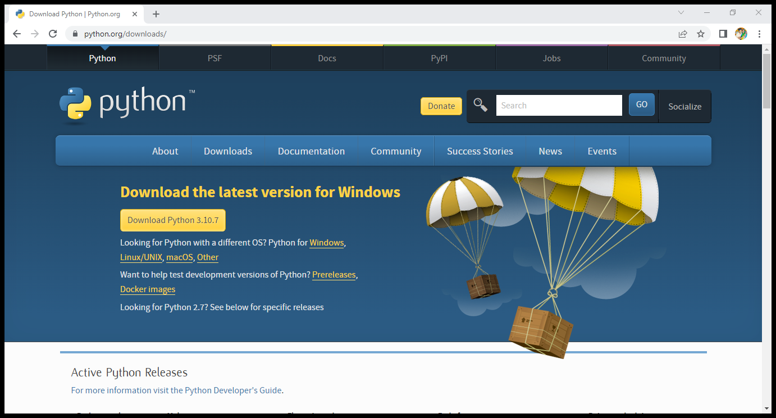

Slide 4
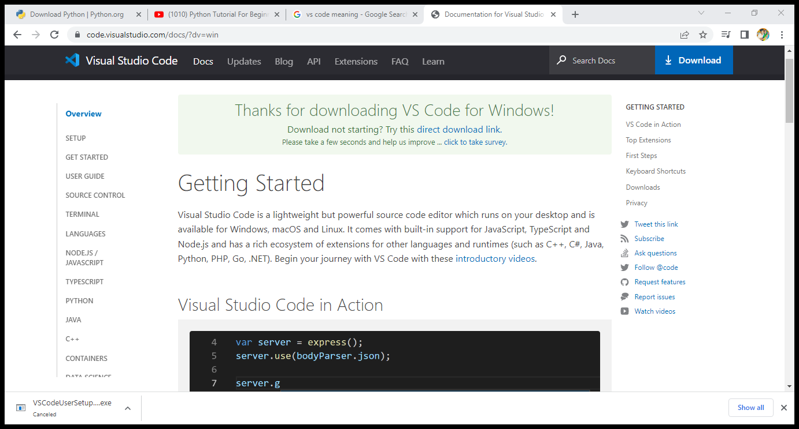
DOWNLOAD V.S. CODE
V.S. code:- visual studio is a streamlined code editor with support for development operators like debugging , task running and version control. Its main aim to provide just the tools a developer need for a quick-build –debug cycle and leaves more complex workflows to fuller featured IDEs, such as visual studio IDE .

Slide 5
AFTER SET UP
Starting the python :-
1.Check the python is installed or not type python and enter
2. Then check the version of the python
3. Then create one file in note pad and save it
4. Then run that file in the windows terminal or command prompt
5. Python file name and type .PY
6.Out put will appear like hello world or something what we are typed in the note pad

Slide 6
Variable:-
A python variable is a systematic name that is a reference or pointer to an object . Once an object is assigned to a variable , you can refer to the object by that name . But the data itself is still contained within the object.
Variables cannot start with any number like 0-9 not correct
1=Paramesh
We can use (a-z),a-z and (0-9)
Start notepad lets start to the variable like as follow:-
Let
x=4
Y=“Paramesh”
Print(X)
Print(y) then save it and execute in the windows terminal

Slide 7
DATA TYPES
Data types :- a data type in a programming , is a classification that specifies which type of value a variable has and what type of mathematical or logical operation can be applied to it without causing an error.
Mainly data types are 8 types
1 text type
2 Numeric type
3 sequence type
4 mapping type
5 set type
6 Boolean type
7 binary type
8 none type

Slide 8
Test type:- test type contains the bunch of data – string numeric type :- like integer , float and complex example:- a=1 integer b=2.0 float c=3a complex to check print (type(A) then execute it sequence type:- example:- list1 = [“prem”, “Raju”, “nandu”, “Kamal” , “Teja”, “ Manoj”, “Priya” type print (list1) and save it then execute it or run tuple :- it stores multiple values in a single variable example:- tuple1(“1” , “2”, “3”, “4”, “5”) print(tuple)

Slide 9
Dictionary :-dictionary is a key value Paire dictionary:- example:-dics1={“name”: “what is my name” “OS” : “windows” “version” : “version11” print (dics1) save it and execute it.

Slide 10
CONDITIONAL :-
Conditionals are mainly defined as 4 types
If else
Loop
While loop
Function
Array
Conditional statements :-Condition:-equal, not equal, less than , greater than , less than or equal to , greater than or equal
==
!=
a<b
a>b
a<=b
a>=b

Slide 11
FUNCTIOND AND ARRAY
Function :-it is a set of instruction
Example :- my –function ():
Print (“hello from function “)
Save it and run it
ARRAY:-it is a data structure which consist of collection of elements

